Slide 1
Multilevel Linear Models
Prof. Andy Field

Slide 2
Aims
Multilevel Models
Hierarchical Data
Intraclass Correlation
Benefits
Fixed and Random Coefficients
Comparing Models
Covariance Structures
Centring
Conducting and Interpreting an example analysis
Growth Models
Types of Growth Model
Conducting and Interpreting an example analysis

Slide 3
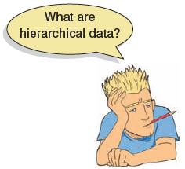
Hierarchical Data
Data structures are often hierarchical
Examples:
Children nested within classrooms
Data points nested within people
Employees nested within organisations
Patients nested within hospitals
Patients nested within doctors nested within clinics

Slide 4
A Two-Level Hierarchy

Slide 5
A Three-Level Hierarchy

Slide 6
Intraclass Correlation (ICC)
Data from the same context will be more similar than data from different contexts
E.g. Children in the same class will perform more similarly than children from different classes
Lack of independence
Creates problems in ANOVA/Regression (correlated residuals)
The ICC measures the variability within contexts
E.g. the variability within classrooms

Slide 7
Benefits of Multilevel Models
Homogeneity of regression slopes
Model the variability in regression slopes
Assumption of independence
You can model the relationships between cases
(Regression for repeated observations)
Missing Data
MLMs can cope with missing data

Slide 8
An Example: Cosmetic Surgery
Post_QoL
This is a measure of quality of life after the cosmetic surgery.
Base_QoL
Quality of life before the surgery.
Surgery
A dummy variable that specifies whether the person has undergone cosmetic surgery (1) or whether they are on the waiting list (0).
Clinic
Which of 10 clinics the person attended to have their surgery.
Age
The person’s age in years.
BDI
Natural levels of depression measured using the Beck Depression Inventory (BDI).
Reason
This dummy variable specifies whether the person had/is waiting to have surgery purely to change their appearance (0), or because of a physical reason (1).
Gender
Whether the person was a man (1) or a woman (0).

Slide 9
Hierarchical structure of cosmetic surgery data set

Slide 10
Fixed vs. Random Coefficients
Intercepts and slopes can be fixed or random
In OLS regression they are fixed
Fixed Coefficients
Intercepts/slopes are assumed to be the same across different contexts
Random Coefficients
Intercepts/slopes are allowed to vary across different contexts

Slide 11
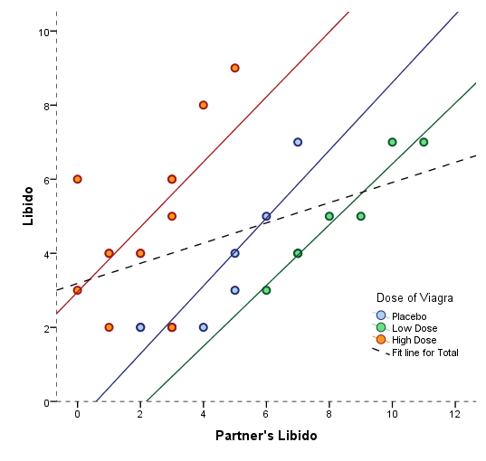
Random Intercept, Fixed Slope

Slide 12
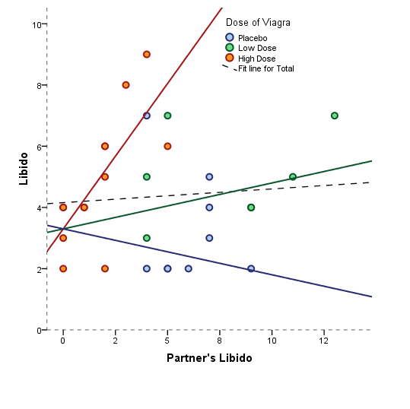
Fixed Intercept, Random Slope

Slide 13
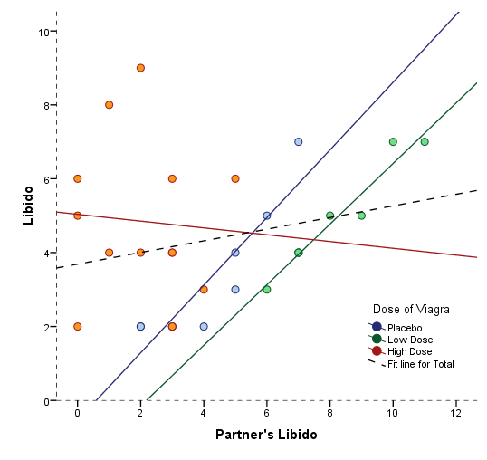
Random Intercept, Random Slope

Slide 14
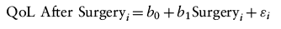
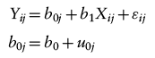
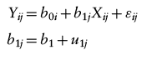
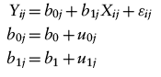
How to Represent These Models
Fixed Intercepts and Slopes
Random Intercepts and Fixed Slopes
Fixed Intercepts and Random Slopes
Random Intercepts and Random Slopes

Slide 15
Adding another predictor
Imagine we wanted to add quality of life before surgery to the model:
We can predict a given person’s quality of life after surgery:

Slide 16
Assessing the fit and comparing Models
Assessing fit
AIC
AICC
BIC
CAIC
Models should be built up gradually
Start with fixed coefficients
Change 1 aspect of the model and compare to the previous with the change in the -2loglikelihood

Slide 17
Covariance Structures
Variance components
Random effects are independent with similar variances
Diagonal
Random effects are independent with different variances
AR(1)
Random effects are related with data points closer in time being more similar than those distant in time
Variances of random effects are similar
Unstructured
Covariances and variances of random effects are unpredictable

Slide 18
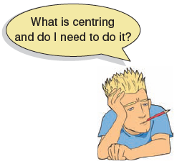
Centring
Group-mean centring
Take each score and subtract from it the mean of scores from the same group (for that variable)
Effects of centring in multilevel models
The effects are complicated
Models using centred variables tend to be more stable
It can help with problems of multicollinearity

Slide 19
Multilevel Models on SPSS

Slide 20
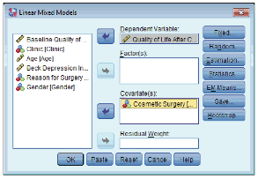
Multilevel Models: Defining Variables

Slide 21
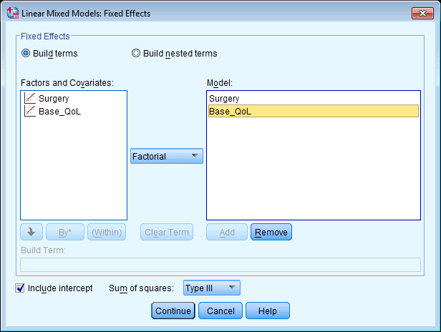
Specifying Fixed Effects

Slide 22
Specifying Random Intercepts

Slide 23
Output: Random Intercepts

Slide 24
Output: Random Intercepts II

Slide 25
Specifying Random Intercepts and Slopes

Slide 26
Output: Random Slopes and Intercepts

Slide 27
Estimating Covariance between Intercepts and Slopes

Slide 28
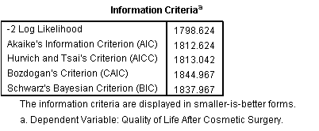
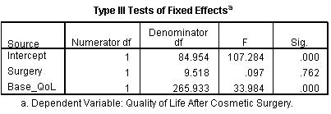
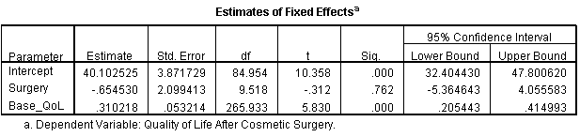
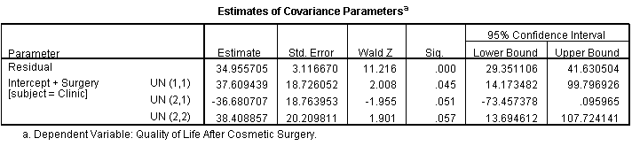
Random Slopes and Intercepts that Covary

Slide 29
The Model

Slide 30
Adding an Interaction

Slide 31
Specifying The Interaction

Slide 32
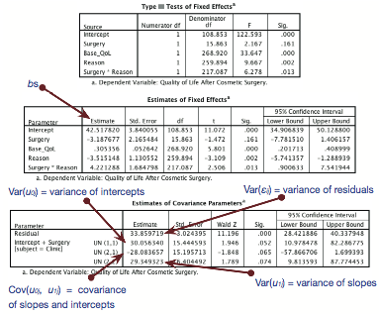
Output

Slide 33
Follow Up Analysis
Surgery for Cosmetic Reasons
Surgery for a Physical Reason

Slide 34
Growth Models
Growth models look at the rate of change of a variable over time
Depression over 8 weeks of treatment
Back pain over 10 weeks of physiotherapy
Profits over months of the year
Radioactive decay

Slide 35
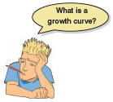
Types of Growth Curve

Slide 36
An Example: The `Honeymoon Period’
Speed Dating Event
After a speed dating event data were collected on all people who ended up in a relationship with the person that they met on the speed-dating night.
None of the people measured were in the same relationship.
Satisfaction_Baseline
A10-point scale (0 = completely dissatisfied, 10 = completely satisfied)
Satisfaction_6_Months
Life satisfaction at 6 months (0-10)
Satisfaction_12_Months
Life satisfaction at 12 months (0-10)
Satisfaction_18_Months
Life satisfaction at 18 months (0-10)
Gender

Slide 37
The Data

Slide 38
Restructuring Data
Data Entry for multilevel models …
Like for regression, needs to be arranged so one instance of the outcome variable is represented in a row of the data editor.
But, in repeated measures designs we’re used to entering data so that instances of the outcome appear in different columns:

Slide 39
Data Entry for a Repeated Measures Multilevel Model

Slide 40
Growth Models in SPSS

Slide 41
Setting up the linear Polynomial

Slide 42
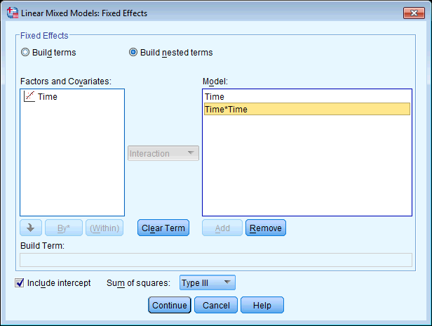
Specifying Linear (Time) and Quadratic (Time*Time) Trends

Slide 43
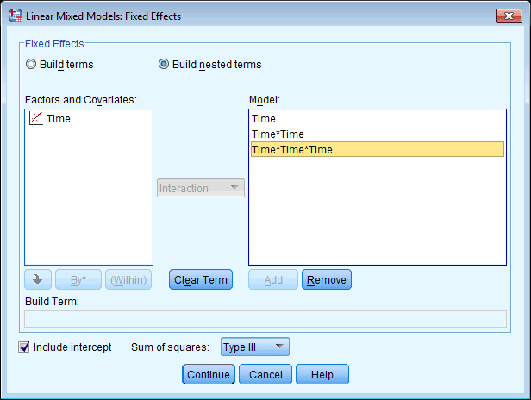
Specifying Linear (Time), Quadratic (Time*Time) and Cubic (Time*Time) Trends

Slide 44
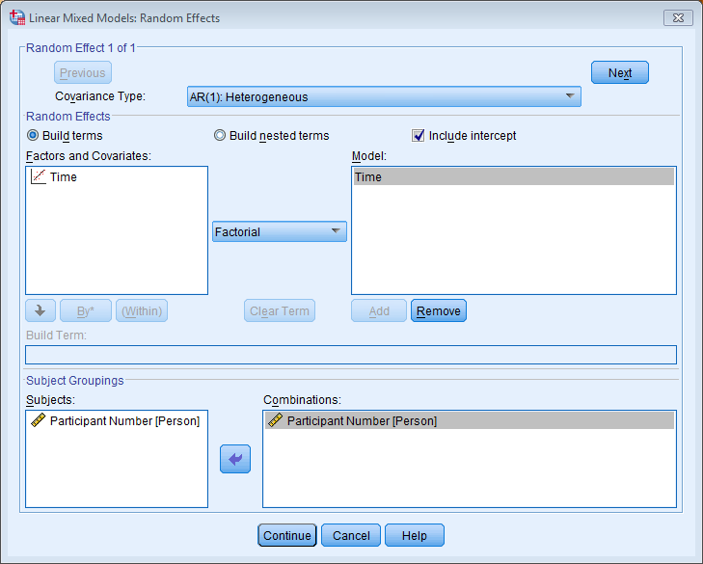
Specifying Random Effects

Slide 45
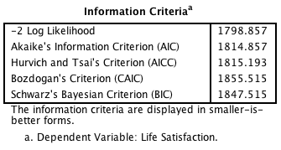
Output from a Growth Model

Slide 46
To Sum Up …
Data can be hierarchical and this hierarchical structure can be important.
Most of the tests that you learn simply ignore the hierarchy.
Hierarchical models are just a fancy regression in which you can estimate the variability in the slopes and intercepts within entities.
i.e. slopes and intercepts can be random variables (allowed to vary) rather than fixed (assumed to be equal in different situations).
Start with a model that ignores the hierarchy and then add in random intercepts and slopes to see if they improve the fit of the model.
Growth curves model trends in the data over time
These trends can also have variable intercepts and slopes.

